Slide 1
Intro to R Programming

Slide 2
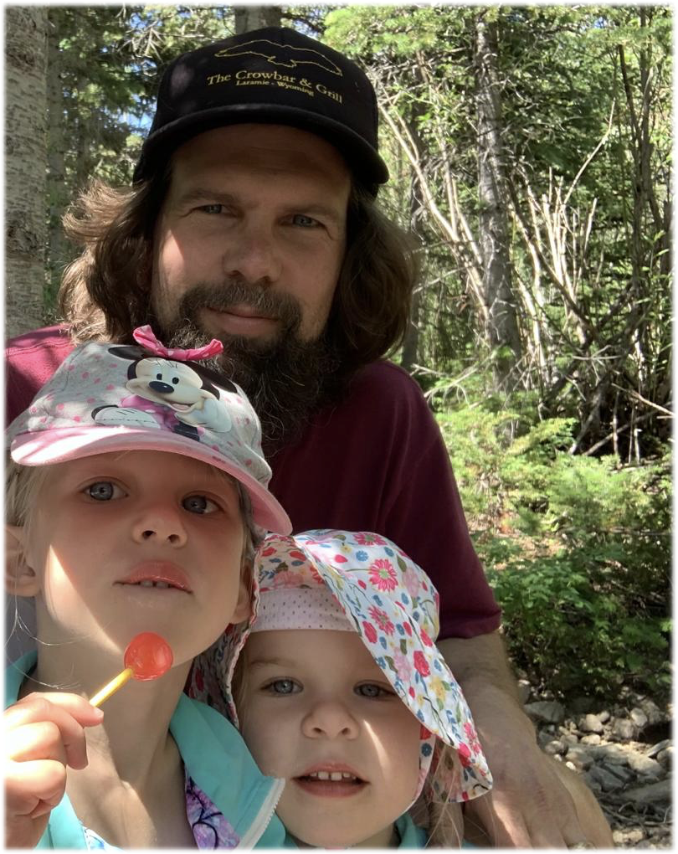
Rob Baker
Data Scientist/National Park Service
Formal education entirely biology (plant evolution, development, genetics, etc)
PhD in Ecology and Evolutionary Biology
NSF Postdoc in Quantitative Genetics
Assistant Prof. of Biology
Currently work for the National Park Service
First introduced to R in 1999. But really… came kicking and screaming to R during my Ph.D.
Mainly develop in R, build tools for data management, metadata construction, etc (“NPSdataverse”)
Even as a “power user” of R I only scratch the surface the capability/potential

Slide 3
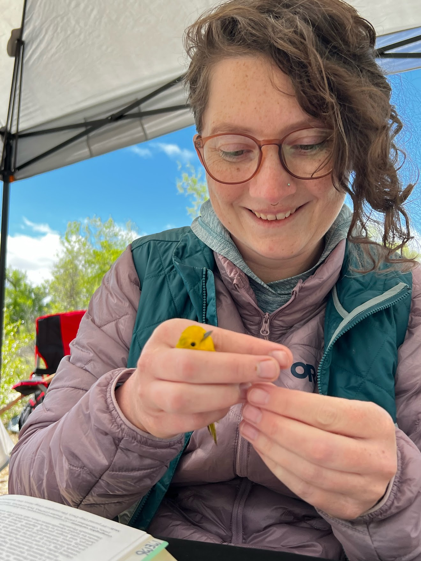
Sarah Wright
And why she is so awesome
Education: bachelor’s in Comp Sci, undergrad assistant in interdisciplinary bio lab
Work: National Park Service data management/data science since 2014
Learned R, databases, Git/GitHub largely on the job circa 2015
Develop custom R packages for data analysis, publication - many in collaboration with Rob

Slide 4
Introduce yourself
~30 seconds each
Name
Department/Field
Project (if you know it)
What you hope to get out of this course
What is your most frequently used emoji? (🙄)

Slide 5
WHY FOCUS ON R?
Rich Ecosystem of packages
Wealth of statistical analysis tools/capabilities
Highly configurable data visualization
Focus on reproducibility and documentation
Integration with other common tools
Open Source

Slide 6
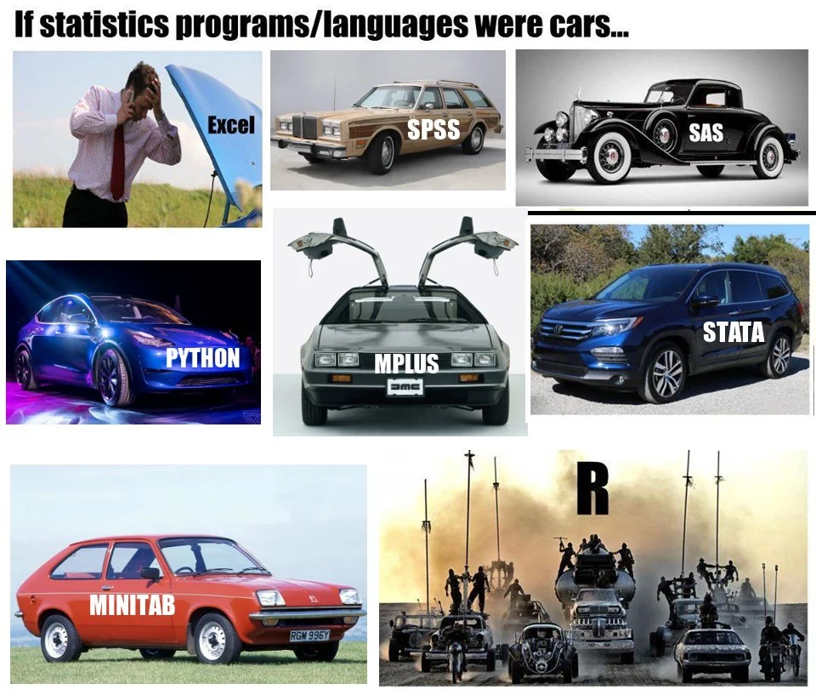
WHY FOCUS ON R?

Slide 7
CODE AND YOUR RESEARCH
Make your life easier and better!
REPRODUCIBILITY
If you make a mistake, you can fix it and re-run your code
You can give your code to someone else and they can verify it
You can deploy your old code to a new but similar problem
Gain credibility by essentially “showing your work”
If it is well documented, it’s like a note to your future self on how you did something

Slide 8
CODE AND YOUR RESEARCH
Make your life easier and better!
TRANSPARENCY
Other people can see how you did your work
Other people can verify your work and approve it (your PI: for submission; journal reviewers: for publication)
Other people in your field can evaluate your work more easily for themselves

Slide 9
CODE AND YOUR RESEARCH
Make your life easier and better!
SHARING AND COLLABORATION
Much easier to get help from others in your research group
Much easier to share with people outside your group
New ideas & perspectives, new directions and discoveries

Slide 10
CODE AND YOUR RESEARCH
Make your life easier and better!
PUBLISHING
Sharing your data and code is now required for publication in many journals!
Even if it’s not required…. Expect reviewers to request to see it
Be prepared for this: start early, document well, etc

Slide 11
CODE AND YOUR RESEARCH
Make your life easier and better!
FUNDING
Most funding agencies now require data management plans (which can include code, software, scripts, etc)
Most funding agencies require that you make your data, code, and software public

Slide 12
CODE AND YOUR RESEARCH
But coding doesn’t feel like it’s making my work easier (or more fun)
Start small - every step in the right direction is a good step
Have realistic expectations: you won’t be an expert overnight.
Be willing to be vulnerable: sharing your work can be scary!
Understand that we are all learning and improving - as individuals and as communities

Slide 13
EXPECTATIONS FOR THIS COURSE
Hands on coding experience and exposure!
Just exposure is OK!
Meet you where you are - if in class time isn’t cutting it, we are happy to help out of class
We really only have time to graze the surface of several topics. There’s plenty more to learn out here
Like most things . . . you probably won’t REALLY feel like you’ve learned any of this unless you use it in your own work. That’s where the real learning happens

Slide 14
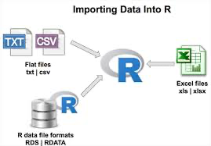
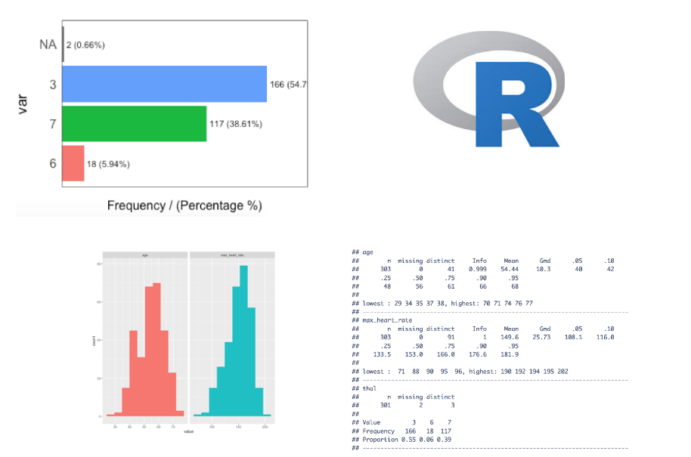
Things you sh/could be able to do after this course
Manage and import data
Basic data QA/QC and data munging
Write for loops and control structures to speed up analysis
Simple text parsing and text scraping
Save/write data files
Basic statistical analysis and interpretation
Data visualization: make some graphs and figures
Document and share your code with non-programmers

Slide 15
Where to find materials?
Expectations:
No no tests, no homework. This course is for YOU and the hope is that it helps your research to the point where you aren’t doing extra work for this course but instead to advance your own research.
Course materials:
Github: www.github.com/rlbaker5/McNair2025
Canvas (I think Jenna is uploading things to the course website? If not I can probably do that too.
Office hours: by appointment
Rob Baker: rob.baker@uwyo.edu
Sarah Wright: s.wright.618@gmail.com

Slide 16
What is Programming?
Step by step instructions that a computer can follow and a human can understand
Lots of different programming languages, but similar patterns:
Do one thing if a condition is met, otherwise do something else
IF Sarah is logged in, display a popup that says “Sarah is the best at R programming”
ELSE IF Rob is logged in, display a popup that says “Rob is ok at R programming”
Apply the same instructions to each thing in a list
FOR every student in this class, display the sentence “[student’s name] is learning R programming”
Do the same thing over and over until a condition is met
WHILE Sarah is talking, Rob has to do jumping jacks
Notes:
The ability to write step by step instructions using these fundamental patterns lets us describe complex and repetitive processes in a (relatively) concise way

Slide 17
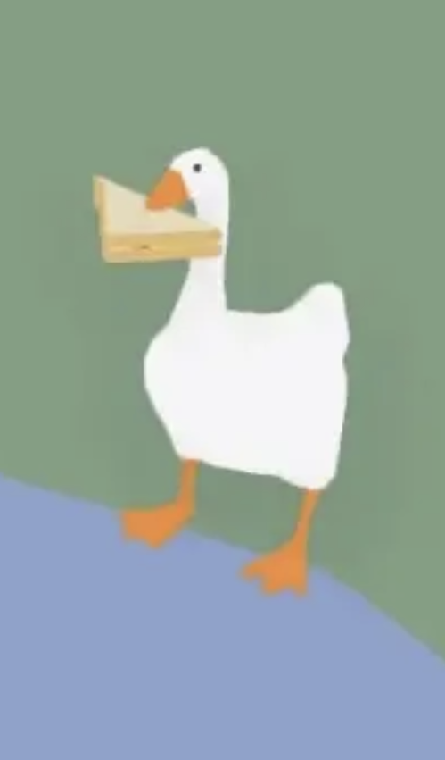
A Note on Syntax
Syntax: how we arrange and structure the building blocks of a language (words, punctuation)
“I walked to the park and saw a goose.” 🖥️✅ 💁‍♀️✅
vs.
“i to the park walked and. saw a goose” 🖥️❌ 💁‍♀️✅
vs.
“Goose park and saw the to a I walked” 🖥️❌ 💁‍♀️❌
Notes:
Humans can understand imperfect syntax (up to a point), but computers need everything to be exactly correct. One missing curly bracket and the whole things comes crumbling down! This is partly what can make it so frustrating to learn at times.

Slide 18
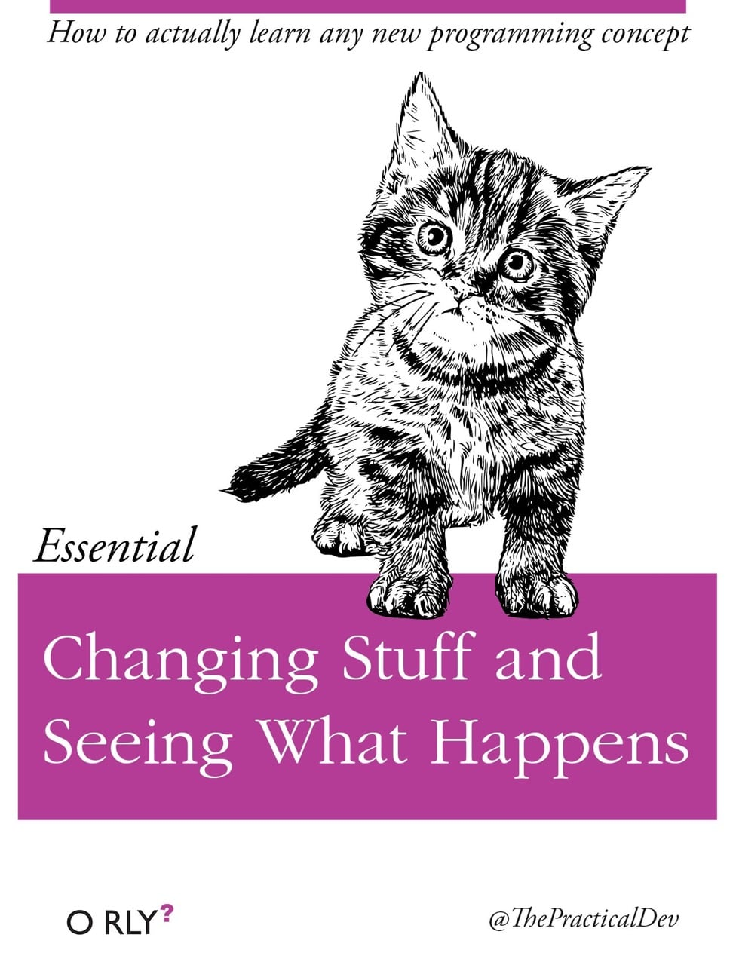
Learning to Program
Be curious and experiment
Don’t be afraid to break your code - troubleshooting is essential to the learning process
Code doesn’t always work on the first try, whether you’re a novice or an expert
Utilize documentation, cheat sheets, help forums (stackoverflow.com is great)
Notes:
As with any language, learning a programming language is a gradual process - you don’t become fluent overnight! It’s good if your code breaks while you’re writing and testing it, because that means you can fix it before it breaks for someone who is actually trying to use it (whether that’s someone else or Future You)

Slide 19
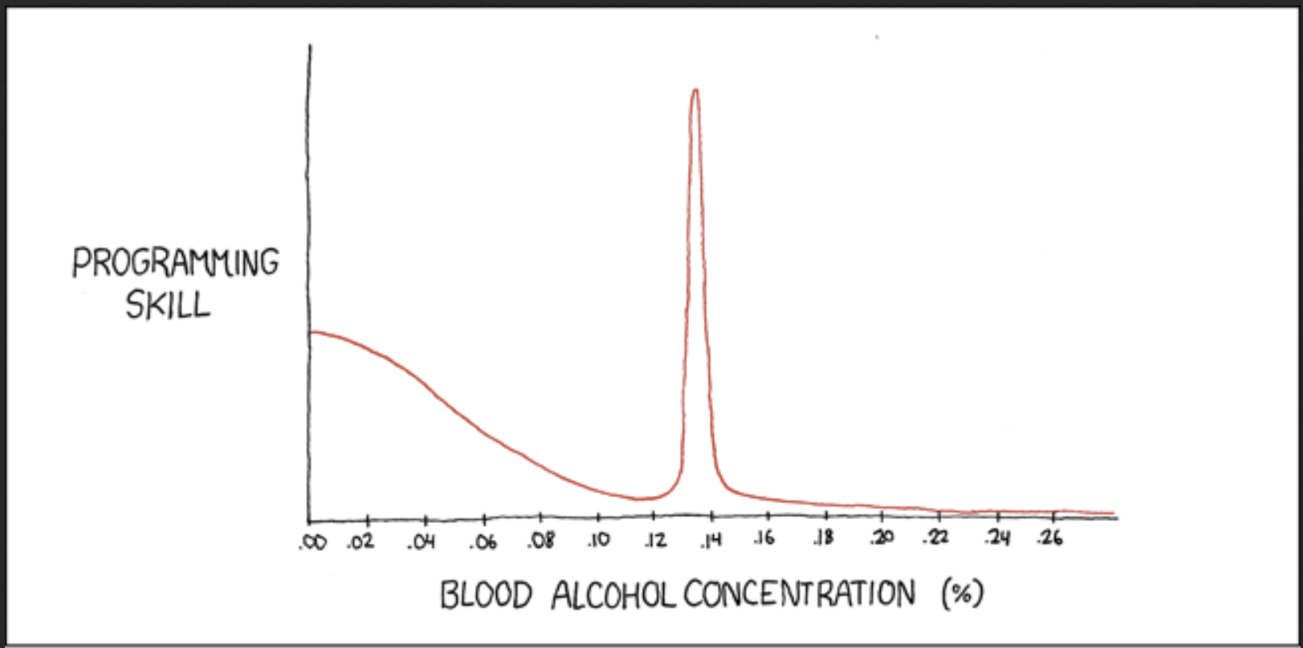
What Makes a Good Programmer Learner?
PATIENCE
Persistence
Humility
Curiosity
Creativity
Empathy
Communication
Organization
Pattern recognition
Reading comprehension
Google search skills
https://xkcd.com/323/
Notes:
When I was going to school for computer science, I internalized this idea that to be a good programmer you had to be exceedingly smart and exceedingly technical and exceedingly logical and ideally you had to have built your own computer prior to the age of 10. And I had a lot of professors who felt like it was their job to weed out anyone who didn’t fit this model of a computer prodigy. I want to push back on that way of thinking. There’s no magical programmer gene that determines whether you’re good at coding or not. Language is a learned skill, and programming is no different. Everyone has a different brain and a different background, and just because a concept isn’t clicking for you or you didn’t build an app when you were a toddler doesn’t mean that your programming future is doomed.

Slide 20
BREAK!
10 minutes?

Slide 21
Variables and Functions
What is a variable?
How to you create a variable?
How do you access a variable?
What is a function?
How do you use a function?
How do you write a function?
Work through an example of a “Hello World” function

Slide 22
Challenge problem
Write a function that:
Will take any number and multiply it by 10.

